Slide 1
Needfinding
Consumo, Aaron Sebastian D.
Conche, Robert Vincent S.

Slide 2
What activity did you choose to examine?
Players/Gamers who play CS:GO(Counter-Strike : Global Offensive)

Slide 3
What methods did you examine it?
Playing with other CS:GO players
Interviewing other CS:GO players

Slide 4
User Needs
Players need a way to stay updated with the current meta of the CS:GO scene.
Players need a way to practice while away from their personal computers.
Players need a way to know the needed information to win a match in CS:GO

Slide 5
Point of View
“I want to practice even though I am not at home.”
“There are no information on the game to know proper callouts.”
“There are no guides in the game to know where to throw a grenade.”
“I can’t seem to know proper economy in the game.”
I can’t aim properly.

Slide 6
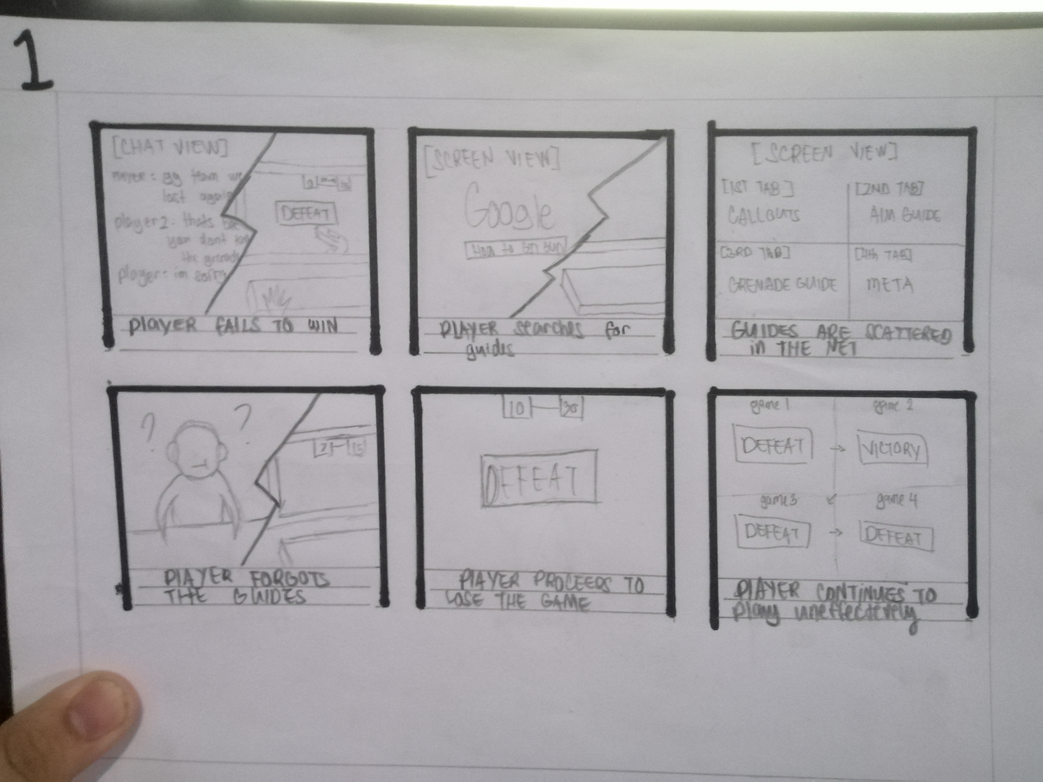
Storyboard

Slide 7
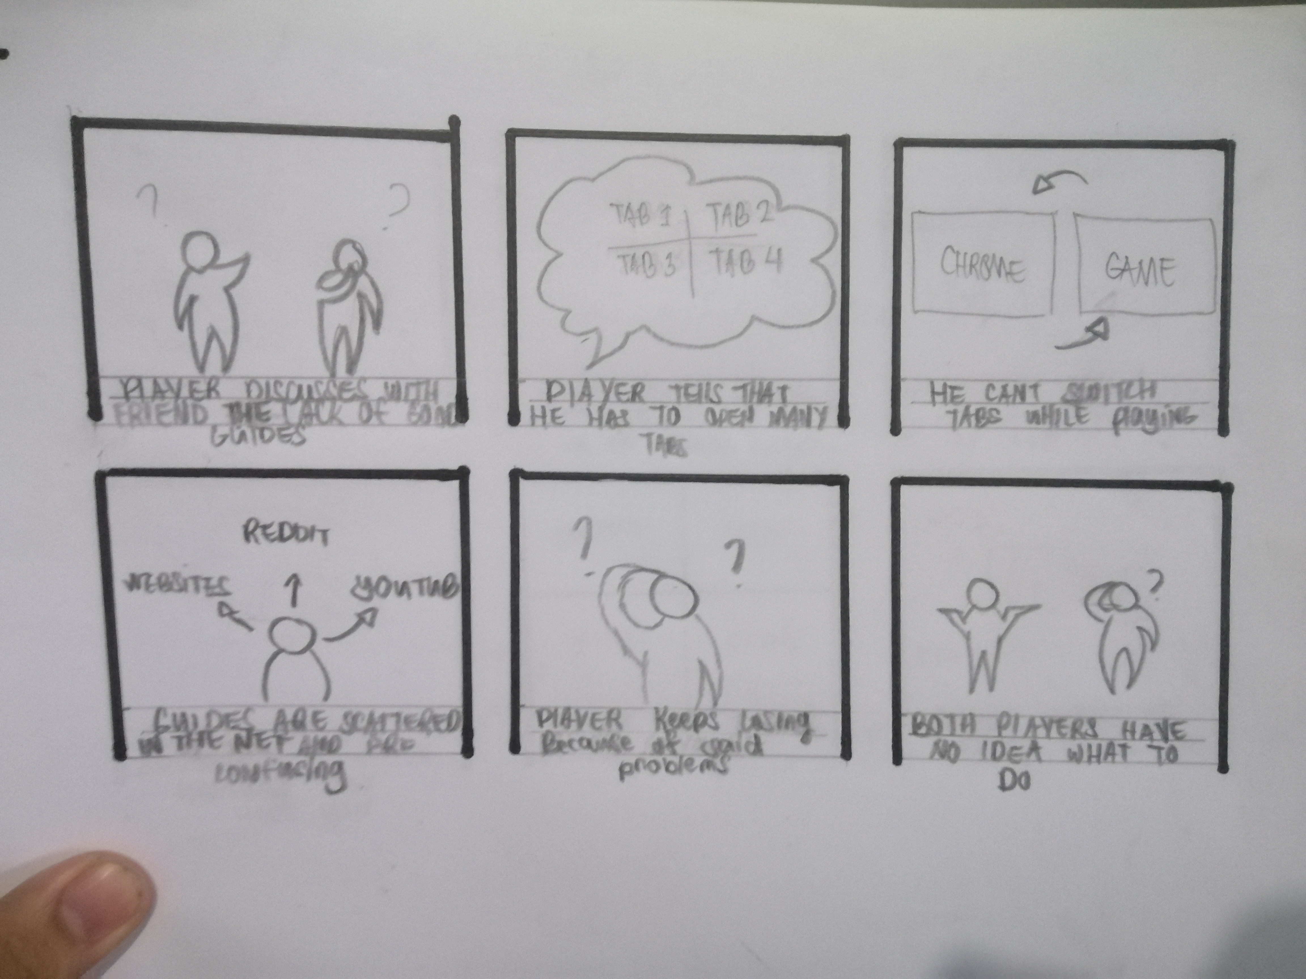
Storyboard

Slide 8
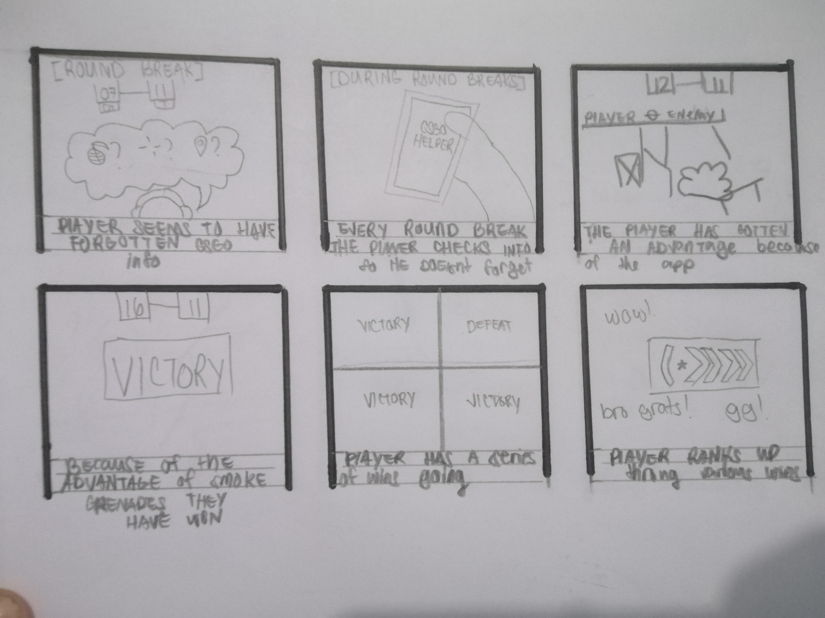
Storyboard

Slide 9
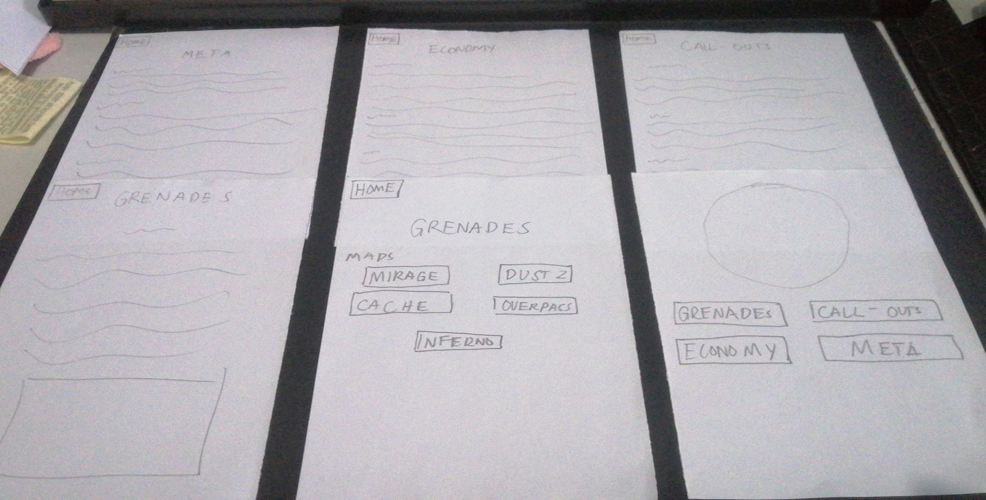

Slide 10
Feedbacks (paper prototype)
“Pwede ba yung callouts gawin picture para mas madali”
“Dapat yung grenade throws mas marami pictures kesa mga words”
“Okay naman yung economy pati Meta”

Slide 11
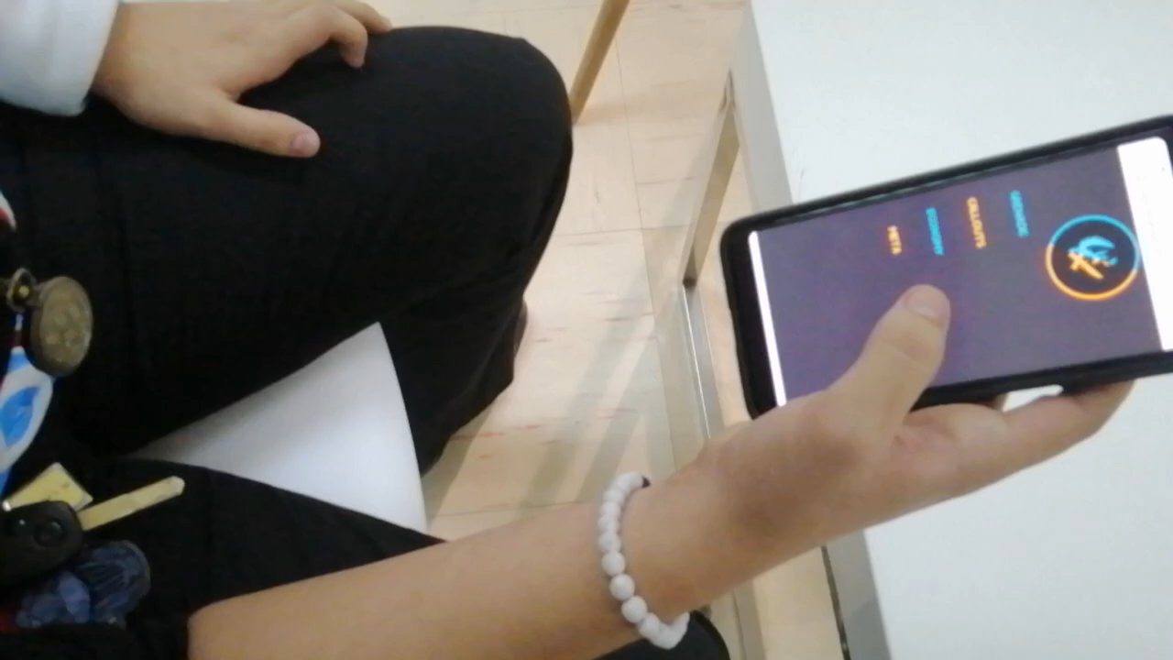
Youtube link: https://www.youtube.com/watch?v=Dnl1Zrg8rb8&feature=share

Slide 12
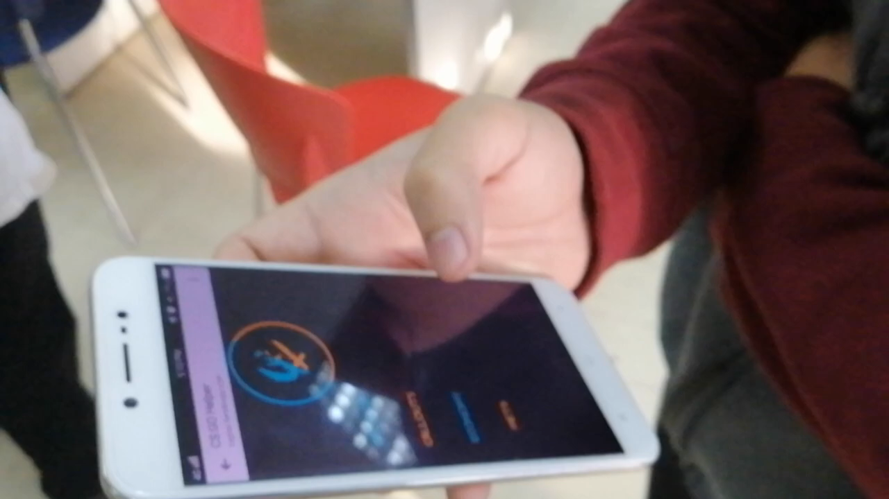
Youtube link: https://www.youtube.com/watch?v=CD8u9KYIzVs&feature=share

Slide 13
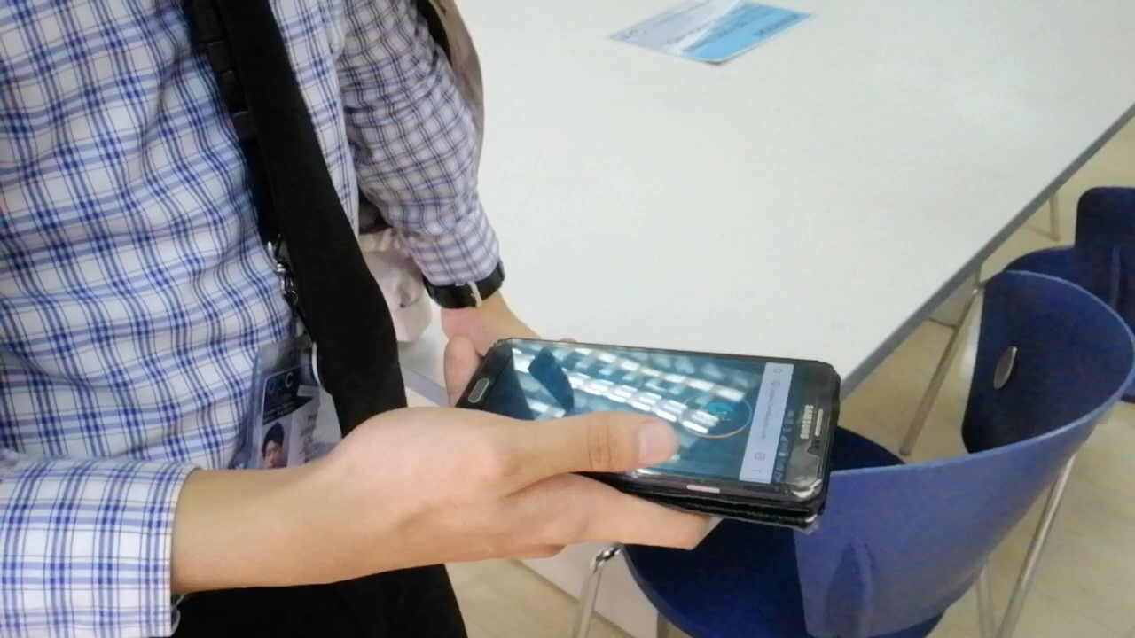
Youtube link: https://www.youtube.com/watch?v=3JObzQmRrws&feature=share

Slide 14
Feedbacks (Demo)
"Okay naman wala na kailangan dagdagan nandito na lahat."
"Accurate naman (Callouts)"
"Gawin mas maganda yung quality ng images"
"Make the logo go back to the home page"
"Anliit ng font"
"Okay naman (Callouts)"
"Ayos naman (Grenade)"
"Wala namang issue tungkol sa looks"

